Slide 1
Programming: data and control
Brandon Wood
Weston Summer 2017

Slide 2
What we’re doing today
Dogging our walk
Pickling (or jamming) numbers
Going up stairs
Alegbra
Hello, World!

Slide 3
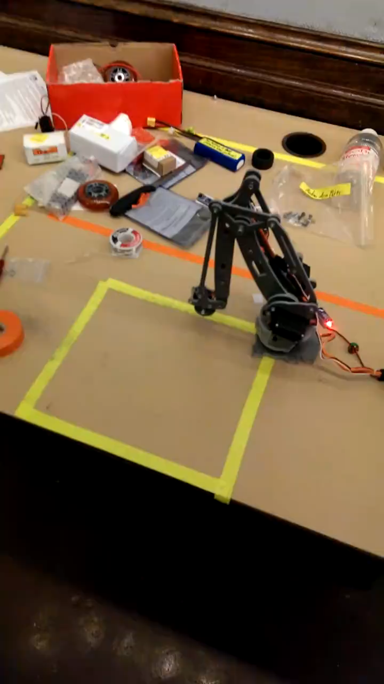

Slide 4
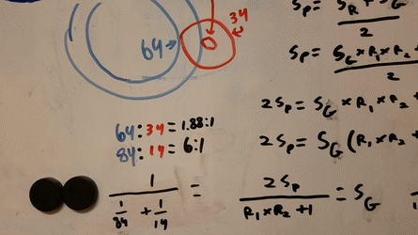

Slide 5
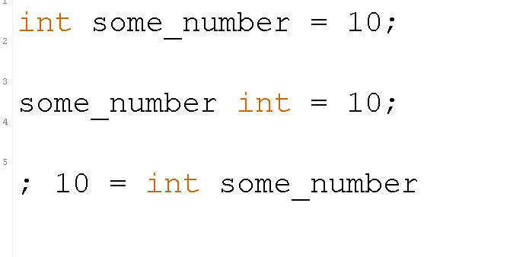
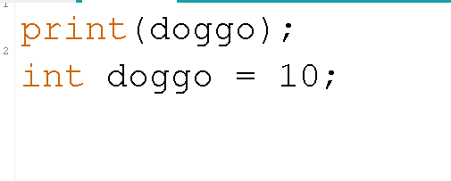
Who has dogged their walk?
Who has walked their dog?
Order Carries Meaning!

Slide 6
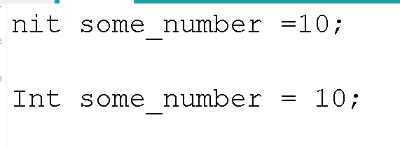
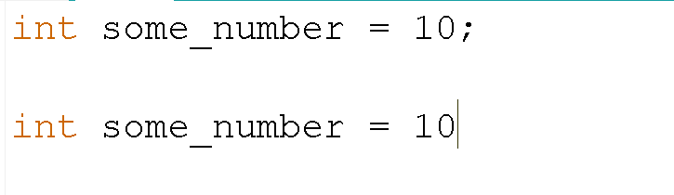
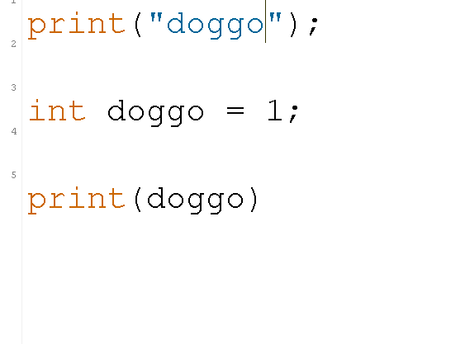
Many rules carry over.
Punctuation
Spelling and capitalization
Quotations

Slide 7
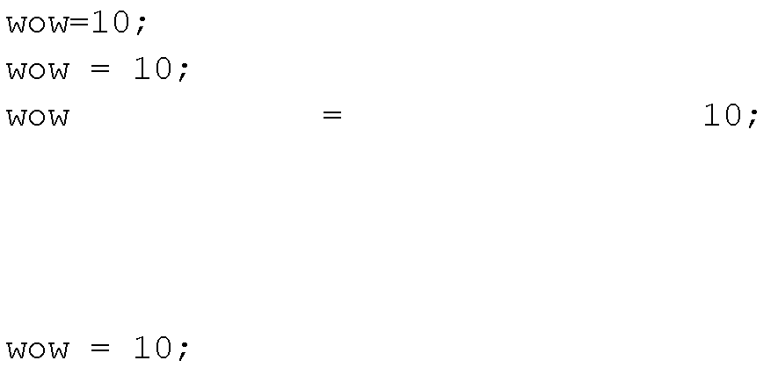
White space doesn’t matter.

Slide 8
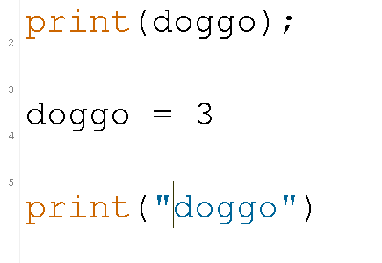
What’s wrong with this?
I want to print
3
3

Slide 9
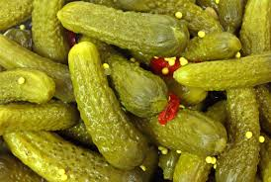
Pickles

Slide 10
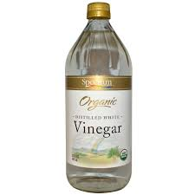

Pickles

Slide 11
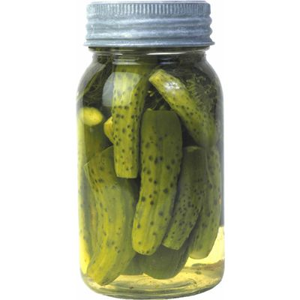
Pickles

Slide 12
We need:
A name
Its purpose

Slide 13
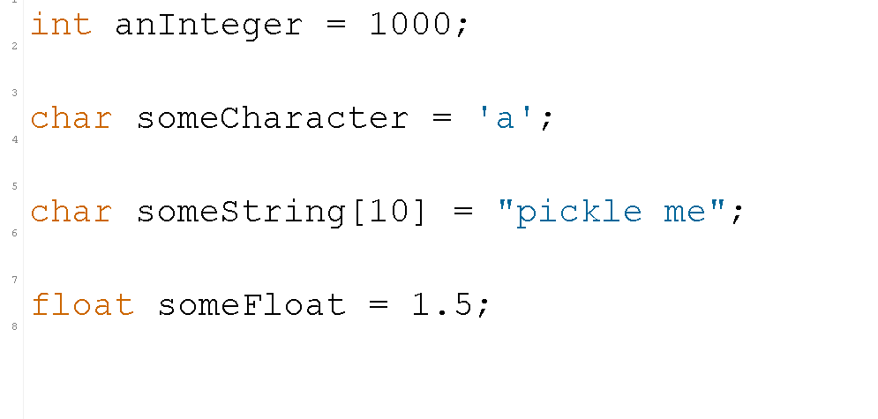
Labeling data

Slide 14
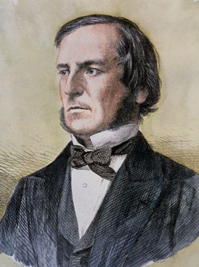
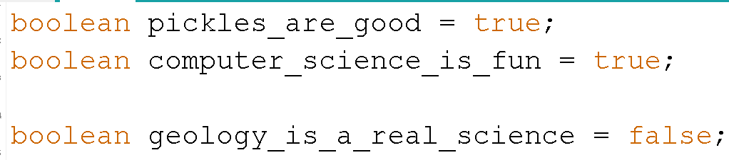
Booleans

Slide 15
Logic!
If(something is true){
Do code here
}else{
Do code here
}

Slide 16
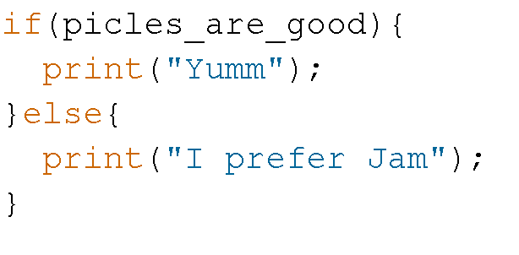
An example:

Slide 17
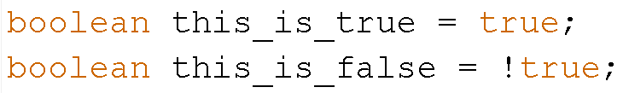
Negating Booleans

Slide 18
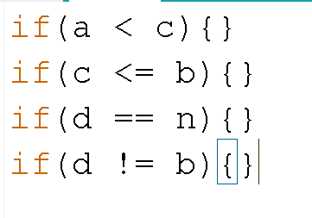
Logic Operators

Slide 19
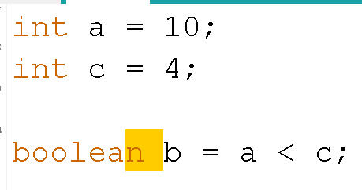
These will make booleans

Slide 20
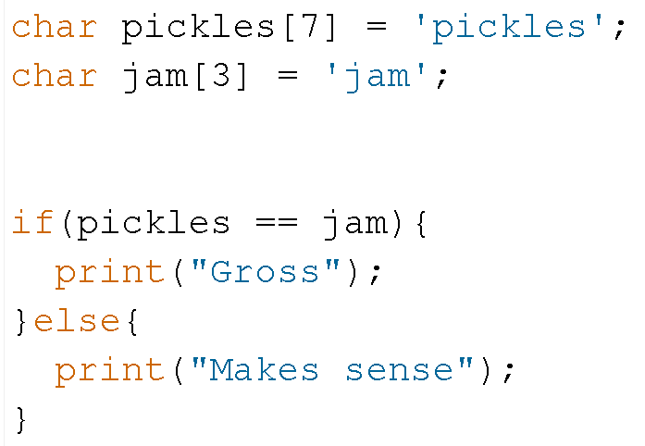
An example

Slide 21
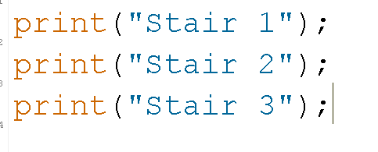
Who likes climbing stairs?

Slide 22
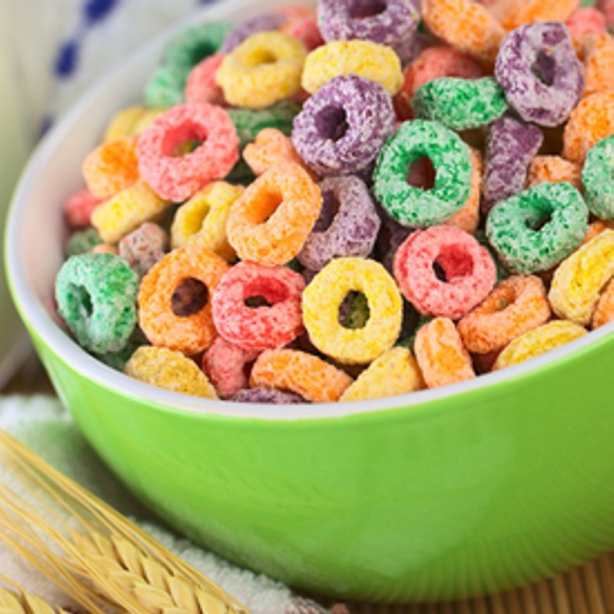
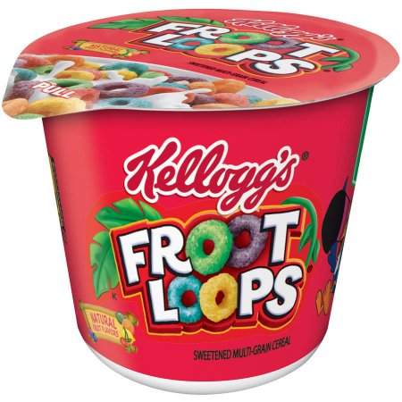
Loops!

Slide 23
While loops:
While I’m waiting for the bus I will pickle my cucumbers.
While the bus isn’t here, I’ll eat fruit loops.
While( something is true){
do some stuff
}

Slide 24
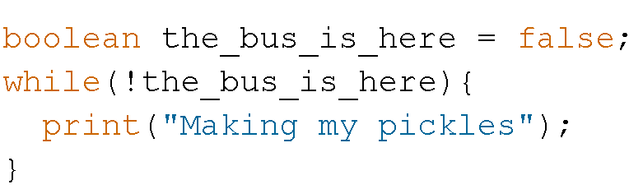
Waiting for the bus

Slide 25
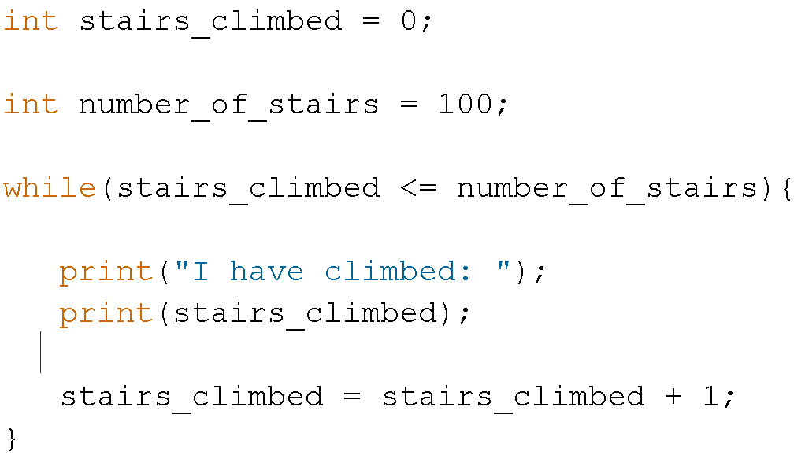
Stairs

Slide 26
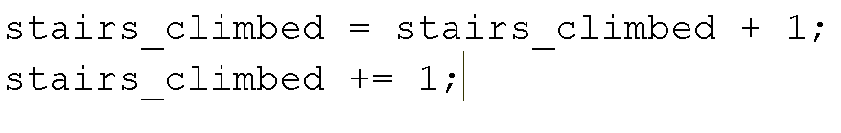
Notation

Slide 27
for( start ; stop; increment){ do something! }
For loops
for( number ; boolean; number += 1){ do something! }

Slide 28
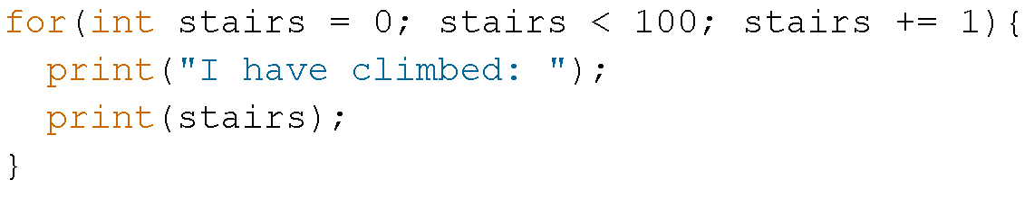
Example:

Slide 29
Any questions?

